Slide 1
Healthy Choices
=
Healthy Living
Talking about Cancer
Notes:
Learning objectives:
Participants will be able to name the four most common types of cancer in the NWT
Participants will know some of the causes of cancer
Participants will understand that living a healthy lifestyle is a way to reduce the risk of developing cancer

Slide 2
What do we know about CANCER?
Notes:
All living things are made up of cells. They are the smallest units of life.
Cancer is a disease that starts in our cells. Our bodies are made up of millions of cells, grouped together to form tissues and organs such as muscles and bones, the lungs and the liver. Genes inside each cell order it to grow, work, reproduce and die. Normally, our cells obey these orders and we remain healthy. But sometimes the instructions get mixed up, causing the cells to form lumps or tumours, or spread through the bloodstream and lymphatic system to other parts of the body.
Tumours can be either benign (non-cancerous) or malignant (cancerous). Benign tumour cells stay in one place in the body and are not usually life-threatening.
Malignant tumour cells are able to invade nearby tissues and spread to other parts of the body. Cancer cells that spread to other parts of the body are called metastases.
The first sign that a malignant tumour has spread (metastasized) is often swelling of nearby lymph nodes (organs in the immune system), but cancer can metastasize to almost any part of the body. It is important to find malignant tumours as early as possible.
Cancers are named after the part of the body where they start. For example, cancer that starts in the bladder but spreads to the lung is called bladder cancer with lung metastases.
Cancers are caused by damage to our DNA. This accumulates over time, so cancer is generally a disease of old age.

Slide 3
In the NWT…
Cancer is the leading cause of death.
25% of all deaths in the NWT are related to cancer.
On average, 111 people are diagnosed with cancer every year.

Slide 4
How many types of cancer are there?
Notes:
Ask class to shout out different types of cancer.

Slide 5
There are over 200 types of cancer.
Notes:
Ask class

Slide 6
Why are there so many types of cancer?
Notes:
Ask class to shout out different types of cancer.
Cancer is a disease of cells. Each different type of cells (e.g. skin, lung, etc) gives rise to a different type of cancer.
Different types of cancer can have different causes and are treated in different ways. We are still better at treating some types of cancer than others, but making progress. Early detection increases chances of survival.

Slide 7
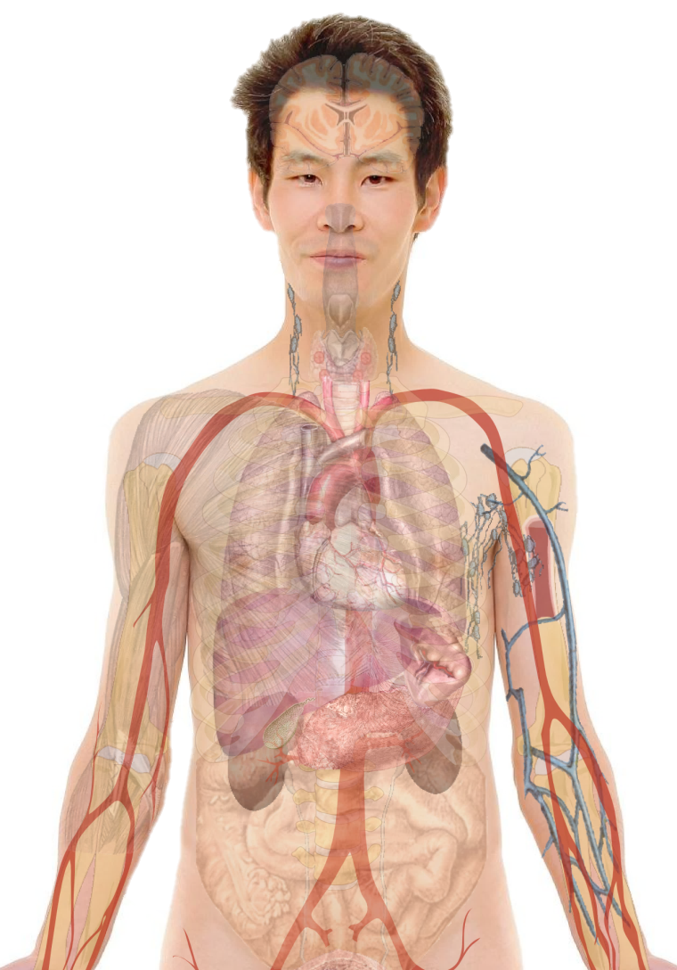
Different cells have different cancers.
Notes:
Ask class to shout out different types of cancer.
Show a diagram of the human body and locate different organs, etc. (e.g. prostate, colon, cervix)

Slide 8
NWT Males
Most common cancers:
Prostate cancer
Colorectal cancer
Lung cancer

Slide 9
NWT Males
Most common cancers:
Prostate cancer
Colorectal cancer
Lung cancer
Most deadly cancers:
Lung cancer
Colorectal cancer
Prostate cancer

Slide 10
NWT Females
Most common cancers:
Breast cancer
Colorectal cancer
Lung cancer

Slide 11
NWT Males
Most common cancers:
Breast cancer
Colorectal cancer
Lung cancer
Most deadly cancers:
Lung cancer
Breast cancer
Colorectal cancer

Slide 12
WHAT CAUSES CANCER?
Notes:
Cause card activity
Divide class into groups. Give each group a set of cause cards.
For each question, each group should decide which card(s) they think show the answer and hold them up. Ask groups to explain their choices. Do all groups agree? Why or why not?
Divide class into 3 groups. Give each group a set of cause cards.
For each question, each group should decide which card(s) they think show the answer and hold them up. Ask groups to explain their choices. Do all groups agree? Why or why not?
Q1: Which of these things do not cause cancer?
A: Water. Remove these cards from game.
Q2: Which ones can you control?
A: Smoking, diet/weight/physical activity, alcohol, UV
Q3: Which one is the most important cause of lung cancer in the NWT?
A: Smoking. Tobacco use is also associated with other cancers. Second-hand smoke is also associated with lung cancer. 17% of Canadians over 15 smoke, but 34% of NWT residents smoke. Lung cancer is the number one cause of cancer death in men and women in the NWT. 25% of cancer deaths in the NWT are from lung cancer.
Discuss: do any of these causes surprise you?

Slide 13
WHAT
CAN WE DO?
Notes:
Now that we know a little about the causes of cancer, what do you think we can do to lower our chances of getting cancer?
Discussion about healthy living to prevent cancer and other chronic disease.

Slide 14
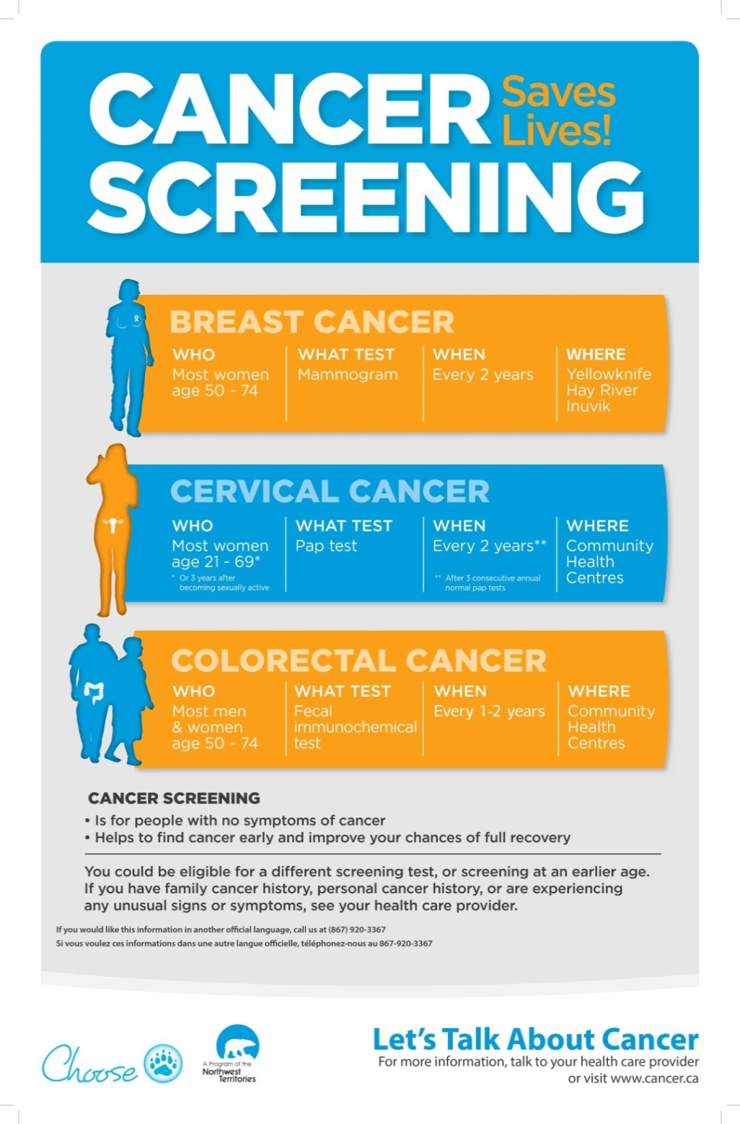
Notes:
It is much easier to treat cancer successfully before it has spread to other parts of the body. That is why early diagnosis is so important: to improve the chances of survival.
Early detection can save lives. Tell your parents and grandparents.

Slide 15
It’s quiz time!
Notes:
Three teams in separate locations equal distance from a bell. Question is asked, and groups confer. Group members take turns running to ring the bell to give answer.
Please see cancer quiz document for questions and answers.

